Slide 1
Binary Arithmetic and Boolean Operators, continued…

Slide 2
One more Boolean operator
The XOR (“exclusive OR”) is a variation of OR
Given any two bits A and B: A XOR B yields 1 if exactly one of A and B is 1, 0 otherwise
Often written as A ⊕ B
Truth table for XOR:
A | B | A ⊕ B
0 | 0 | 0
0 | 1 | 1
1 | 0 | 1
1 | 1 | 0

Slide 3
Truth tables
Remember that a truth table shows the result of a Boolean expression for all possible combinations of its operands
So far we’ve seen truth tables only for the basic Boolean operators (AND, OR, XOR, NOT)
You can also write truth tables for more complex Boolean expressions. Just follow the order of operations!

Slide 4
More complex truth tables
Example: Write a truth table for the Boolean expression A && !B || !A && B
Operands
Intermediate steps
Final result
A | B | !B | !A | A && !B | !A && B | A && !B || !A && B
0 | 0 | 1 | 1 | 0 | 0 | 0
0 | 1 | 0 | 1 | 0 | 1 | 1
1 | 0 | 1 | 0 | 1 | 0 | 1
1 | 1 | 0 | 0 | 0 | 0 | 0
NOT col. 2
NOT col. 1
AND cols. 1, 3
AND cols. 2, 4
OR cols. 5, 6

Slide 5
So what?
It’s fairly easy to construct hardware devices that perform Boolean operations like AND, OR, XOR, NOT
Boolean operations form the foundation of digital circuits, which allow a processor to perform its basic operations like addition or multiplication
Without digital circuits, computers as we know them today wouldn’t exist!

Slide 6
Digital circuits
A digital circuit takes one or more bits as input, performs some Boolean operations on the input, and returns one or more bits as output
Let’s revisit the original aim of these notes: can we construct a digital circuit that allows a computer to perform addition of binary numbers?
Input: Two multi-bit binary numbers
Output: The sum of the two inputs

Slide 7
Adders
We’ve already seen that two multi-bit numbers can be added one column at a time
So, we just need to come up with a digital circuit that handles addition of a single column, and chain them together!
A type of digital circuit called an adder allows us to do exactly this
Two types: half adder (which can add two bits) and full adder (which can add three bits)
Why do you think it’s necessary to have a digital circuit that can add three bits?

Slide 8
Half adder
If we’re just adding two bits together in a single column, what are the possibilities? 0 + 0 = 0 (sum is 0, nothing to carry) 0 + 1 = 1 (sum is 1, nothing to carry) 1 + 0 = 1 (sum is 1, nothing to carry) 1 + 1 = 10 (sum is 0, carry the 1)
The half adder is a digital circuit that takes two bits as input. It has two outputs: the sum and carry.

Slide 9
Half adder
A | B | S | R
0 | 0 | 0 | 0
0 | 1 | 1 | 0
1 | 0 | 1 | 0
1 | 1 | 0 | 1
S = A ⊕ B
R = A && B
Input: Two bits A, B
Output: 1-bit sum S, 1-bit carry R

Slide 10
Half adder vs. full adder
The half adder is great for adding two bits in a single column. But what if we wanted to add 1101 + 1111? Here’s what it looks like:
1 1 1
1 1 0 1
+ 1 1 1 1
----------
1 1 1 0 0
Every column except the rightmost one requires adding three bits, due to the carry from the previous column.
The half adder can add only two bits!
We can design a full adder to add three bits.

Slide 11
Full adder
A | B | C | S | R
0 | 0 | 0 | 0 | 0
0 | 0 | 1 | 1 | 0
0 | 1 | 0 | 1 | 0
0 | 1 | 1 | 0 | 1
1 | 0 | 0 | 1 | 0
1 | 0 | 1 | 0 | 1
1 | 1 | 0 | 0 | 1
1 | 1 | 1 | 1 | 1
S = (A ⊕ B) ⊕ C
R = A && B || C && (A ⊕ B)
Input: Three bits A, B, C
Output: 1-bit sum S, 1-bit carry R

Slide 12
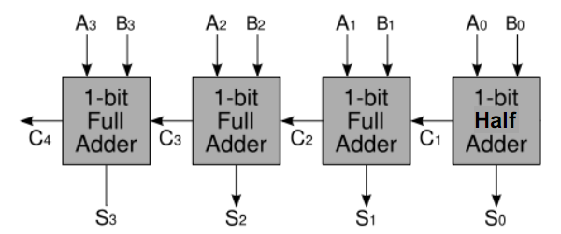
“Ripple-carry” adder
Half and full adders can be chained together to allow addition of multi-bit binary numbers
Input: Two 4-bit numbers A₃A₂A₁A₀, B₃B₂B₁B₀
Output: 4-bit sum S₃S₂S₁S₀, 1-bit carry C₄

